Slide 2
Data visualization in Python
Cindy van de Vries – Safavi Nic & Dave de Koning

Slide 3
Time schedule
16:00-16:30 | Introduction + installation | Dave
16:30-17:30 | Ex1 (last 15 minutes discussion of exercise) | Cindy
17:30-18:00 | Dinner | All
18:00-19:00 | Ex2 (last 15 minutes discussion of exercise) | Dave
19:00-20:00 | Ex3 (last 15 minutes discussion of exercise) | Cindy

Slide 4
Type of plots
Time series
Spatial maps
2D graphs
Categorical plots
Bar charts
Longitudinal charts

Slide 5
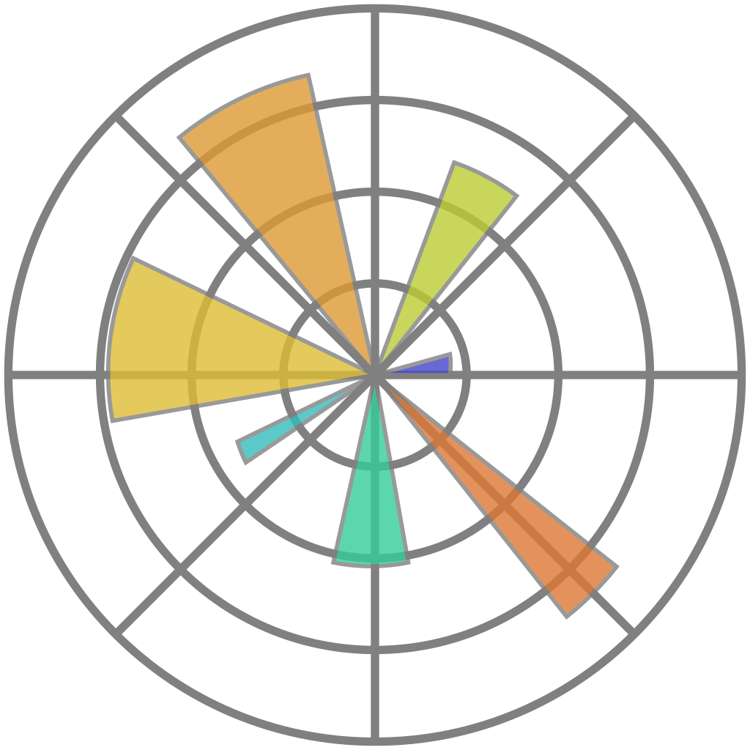

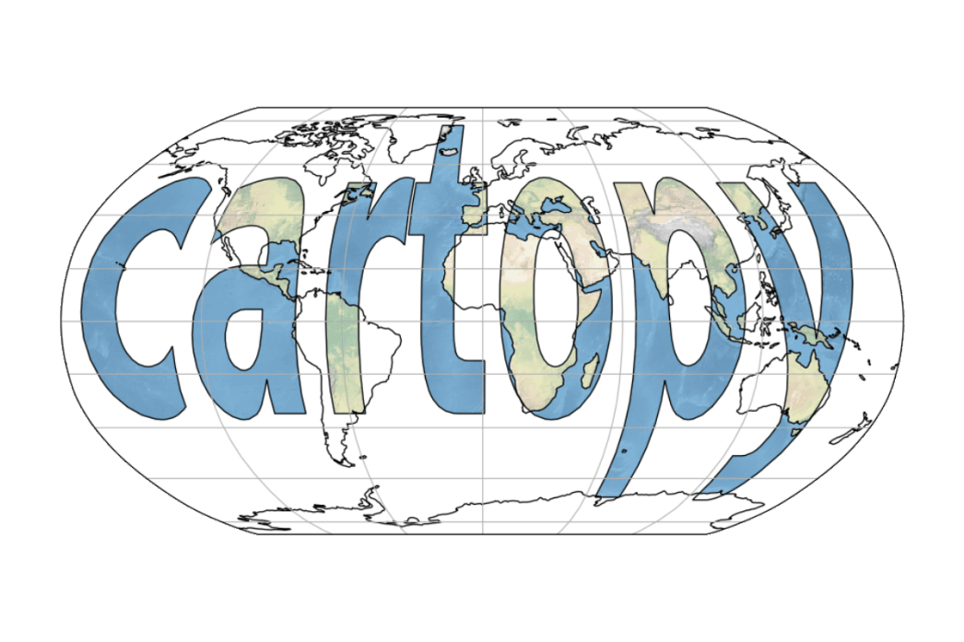


Packages
Matplotlib
Bokeh
Seaborn
ggplot
Cartopy
Altair
Holoviews
Plotly

Slide 6
Ways of plotting

Slide 7
Basic plot

Slide 8
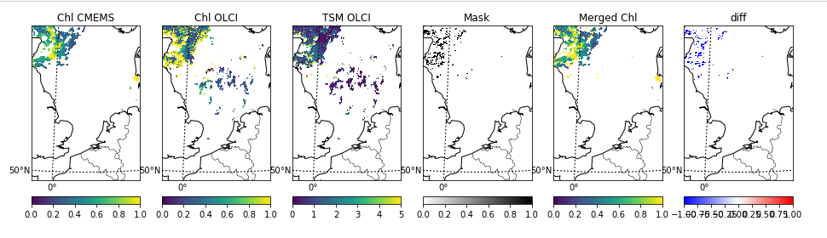

Slide 9
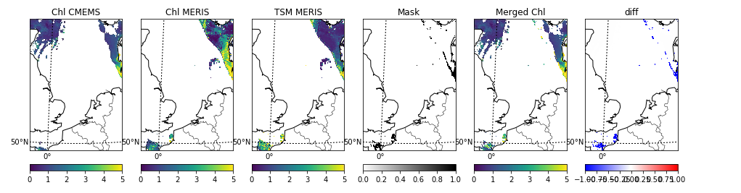

Slide 10
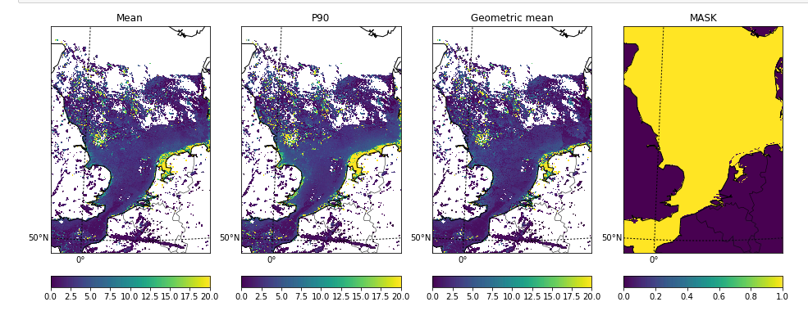

Slide 11
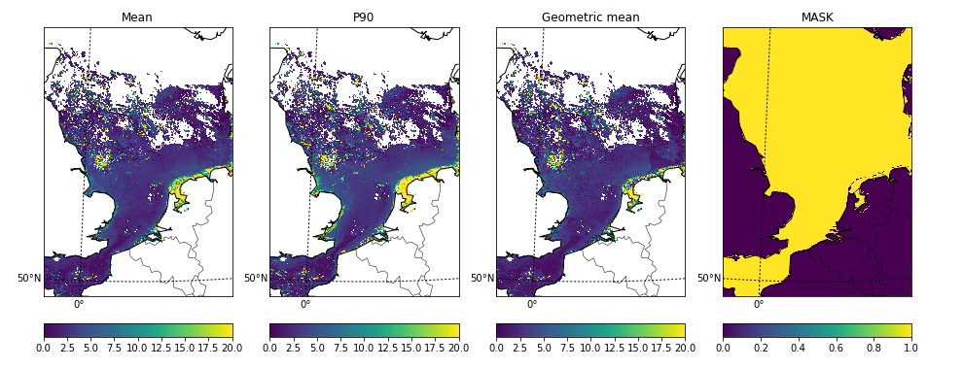

Slide 12
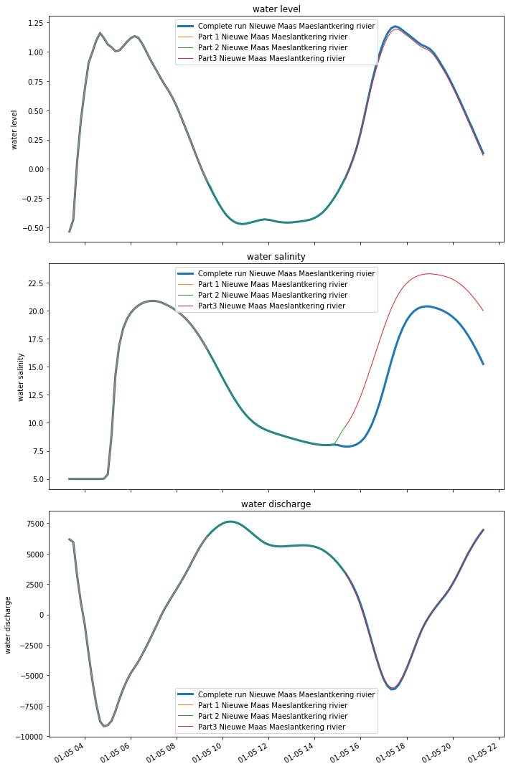

Slide 13
